Slide 1
2016-2017 Edenton-Chowan Schools
Board of Education Orientation Policy Review
#believe #belong #become

Slide 2
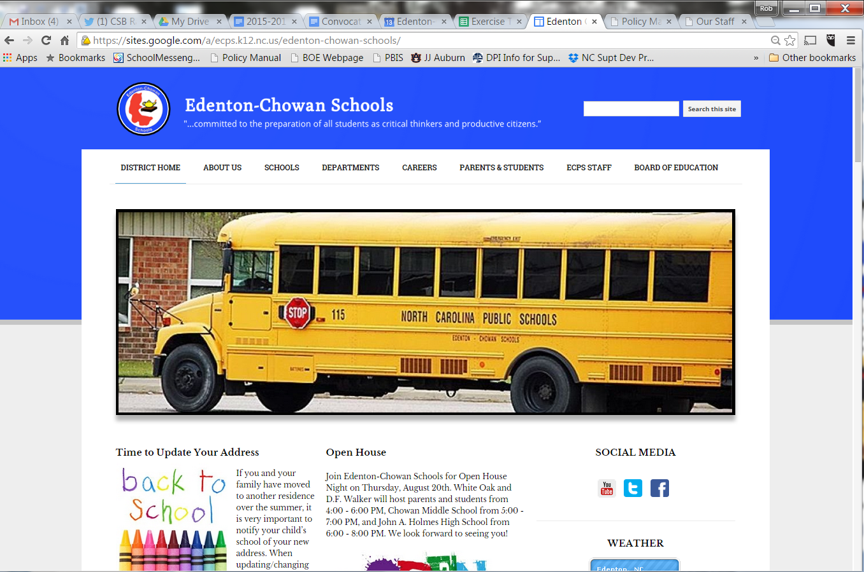
Board of Education Online Policy Manual
www.ecps.k12.nc.us
#believe #belong #become

Slide 3
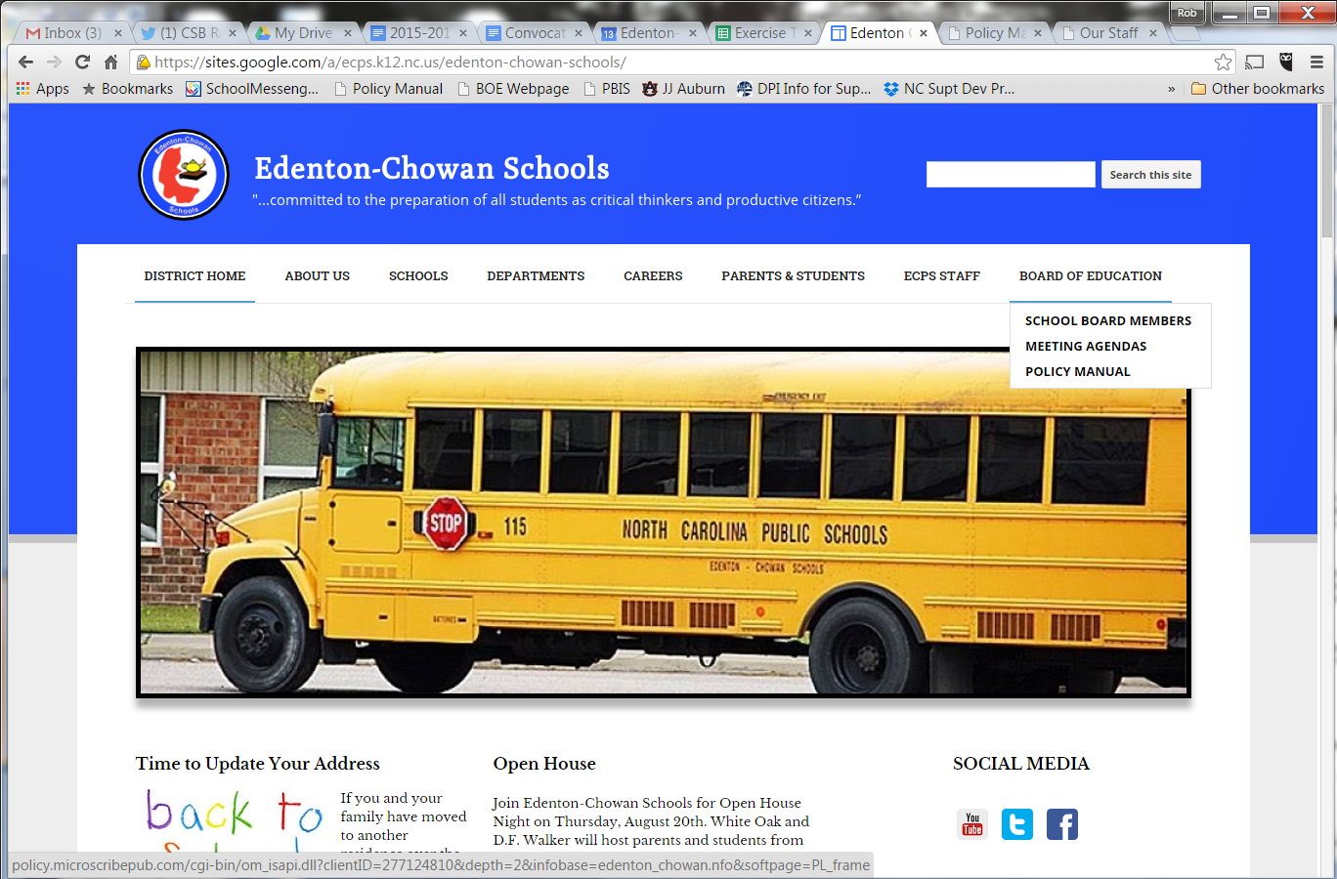
Board of Education Online Policy Manual
#believe #belong #become

Slide 4
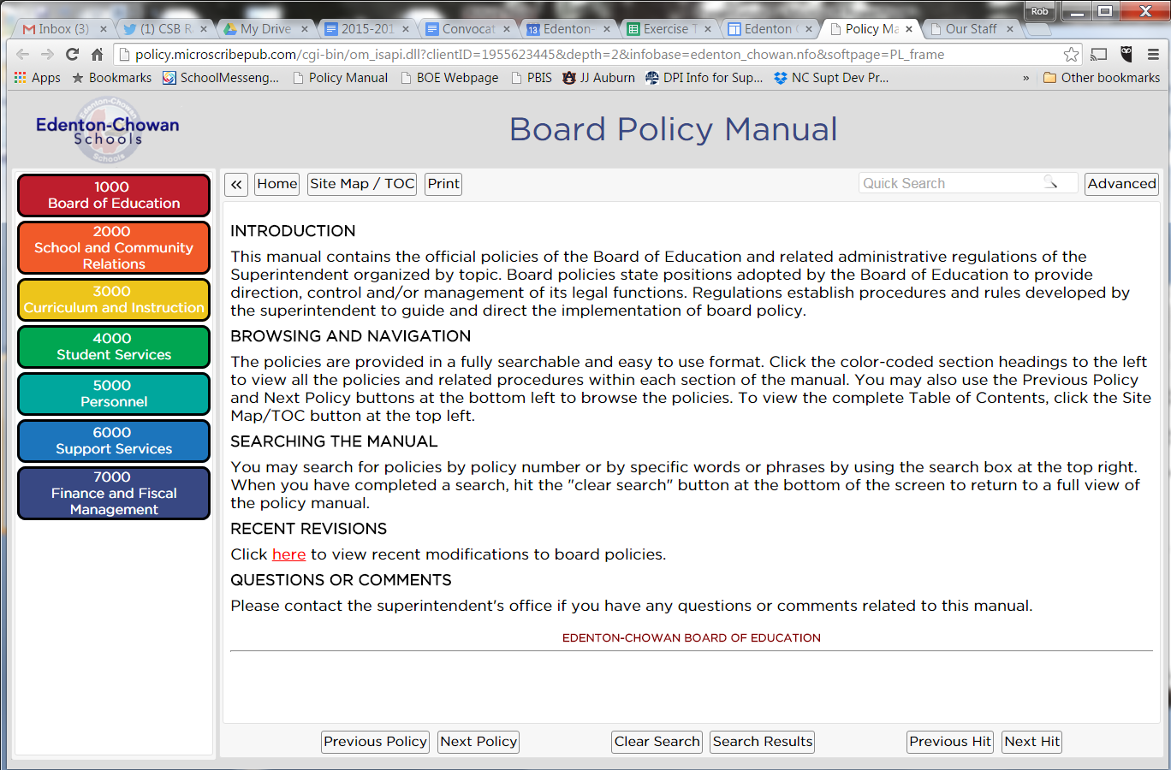
Board of Education Online Policy Manual
SEARCH TERM
#believe #belong #become

Slide 5
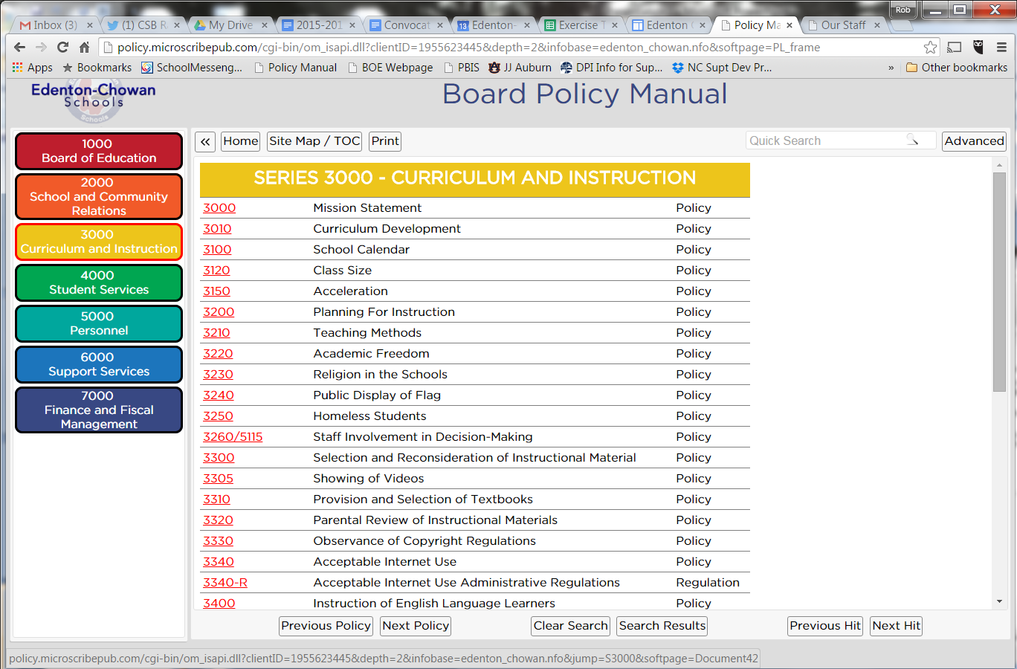
Board of Education Online Policy Manual
#believe #belong #become

Slide 6
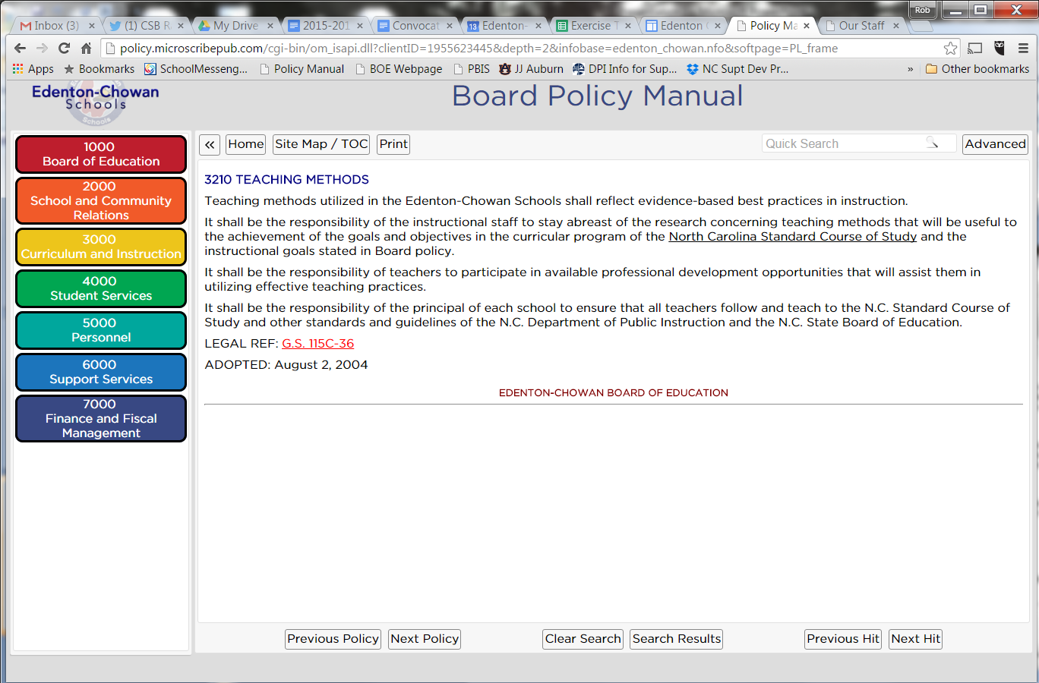
Board of Education Online Policy Manual
#believe #belong #become

Slide 7
Board of Education Orientation Policy Review
Introduction
A copy is located in the principal’s office of each school and at the Edenton-Chowan Schools Administrative Offices. An electronic copy is available on the Edenton-Chowan Schools' official website. All personnel are expected to become familiar with and follow the policies and rules and regulations contained herein.
Policy development in a modern, forward-looking school system is a dynamic, on-going process. New problems, needs, concerns, and issues give rise to the continuing need to develop new policies or to revise existing ones.
The Superintendent and/or designee is responsible for maintaining the policy manual system. The Board encourages employees, parents, and citizens to make written suggestions which will assist in providing a policy manual which meets the needs of the school system.
Policy #1000
#believe #belong #become

Slide 8
Board of Education Orientation Policy Review
Qualifications for Board Members
Any candidate for the Edenton-Chowan Board of Education must be a registered voter in North Carolina, be a resident of the district from which he/she seeks election for at least thirty (30) days, be twenty-one (21) years of age at the time he/she would take office if elected, and not be disqualified because of any constitutional prohibition against holding office in North Carolina.
A person is eligible to serve on the Board if he/she also serves in an appointed office, but shall not be eligible to serve if he/she holds an elected office.
An employee of the Edenton-Chowan Schools is not eligible to serve as a member of the Board.
Policy #1100
#believe #belong #become

Slide 9
Board of Education Orientation Policy Review
Code of Ethics for Members
Board members will act ethically and in the best interest of students, the Edenton-Chowan Schools, and public education in the performance of their official duties.
The board recognizes that, collectively and individually, all members of the board must adhere to a code of ethics as required by G.S. 160A-86 and G.S. 115C-47(57).
While no code of ethics can address all situations, the Board adopts the following Code of Ethics to guide the performance of its members.
Policy #1110
#believe #belong #become

Slide 10
Board of Education Orientation Policy Review
Code of Ethics for Members
The following considerations will guide each board member in the performance of his or her official duties:
the need to obey all applicable state and federal laws regarding official actions taken as a board member;
the need to uphold the integrity and independence of board member’s office;
the need to avoid impropriety in the exercise of the board’s and board member’s official duties;
the need to perform faithfully the duties of the office; and
the need to conduct the affairs of the board in an open and public manner, complying with all applicable laws governing open meetings and public records.
Policy #1110
#believe #belong #become

Slide 11
Board of Education Orientation Policy Review
Code of Ethics for Members
Members of the Edenton-Chowan Board of Education shall:
attend all regularly scheduled Board meetings insofar as possible, and become informed concerning the issues to be considered at those meetings;
endeavor to make policy decisions while always keeping in mind the objective of providing students the opportunity to receive a sound basic education and only after full discussion at publicly held Board meetings;
render all decisions based on the available facts and the Board member’s independent judgment, and refuse to surrender that judgment to individuals or special interest groups;
remember at all times that an individual member has no legal authority outside the meetings of the Board, and conduct relationships with the school staff, local citizenry, and news media on the basis of this fact;
work with other Board members to establish effective Board policies and delegate authority for the administration of the schools to the Superintendent;
communicate to other Board members and the Superintendent expressions of public reaction to Board policies and the school program;
Policy #1110
#believe #belong #become

Slide 12
Board of Education Orientation Policy Review
Code of Ethics for Members
Members of the Edenton-Chowan Board of Education shall:
devote time, thought, and study to the duties and responsibilities of a school Board member, the state school laws, and the policies, rules and regulations of the state and local boards of education;
support the employment of those persons best qualified to serve as school staff, and insist on a regular and impartial evaluation of all staff;
resist every temptation and outside pressure to use the position as a school Board member for personal benefit or benefit of any other individual or agency apart from the total interest of the school district;
conduct the affairs of their office in accordance with the character traits of citizenship, courage, fairness, honesty, kindness, perseverance, respect, responsibility, and self-discipline;
take no private action that will compromise the Board or administration, and respect the confidentiality of information that is privileged under applicable law;
remember always that a Board member’s first and greatest concern must be the educational welfare of the students who attend the public schools;
Policy #1110
#believe #belong #become

Slide 13
Board of Education Orientation Policy Review
Code of Ethics for Members
Members of the Edenton-Chowan Board of Education shall:
bear in mind that the primary function of the Board is to establish the policies by which the schools are to be administered, but that the administration of the educational program and the conduct of school business shall be left to the employed Superintendent of Schools and his/her professional and support staff unless otherwise provided by law;
not accept, directly or indirectly, gifts, monetary amounts or other items of value or any promise of favor or reward from any individual or organization that will serve to influence a decision or action of the Board, officer or employee of the Board, or any individual or group acting for or on behalf of the Board;
fulfill all requirements of Chapter 115C of the North Carolina General Statutes and other duties and obligations imposed by law in a professional manner;
comply with North Carolina General Statute 115C-50 by earning the required 12 hours of training every two years; and
comply with G.S. 160A-87 by earning two hours of ethics education within 12 months of their initial election or appointment to the board and each subsequent appointment or election.
Policy #1110
#believe #belong #become

Slide 14
Board of Education Orientation Policy Review
Code of Ethics for Members
Members of the Edenton-Chowan Board of Education shall:
bear in mind that the primary function of the Board is to establish the policies by which the schools are to be administered, but that the administration of the educational program and the conduct of school business shall be left to the employed Superintendent of Schools and his/her professional and support staff unless otherwise provided by law;
not accept, directly or indirectly, gifts, monetary amounts or other items of value or any promise of favor or reward from any individual or organization that will serve to influence a decision or action of the Board, officer or employee of the Board, or any individual or group acting for or on behalf of the Board;
fulfill all requirements of Chapter 115C of the North Carolina General Statutes and other duties and obligations imposed by law in a professional manner;
comply with North Carolina General Statute 115C-50 by earning the required 12 hours of training every two years; and
comply with G.S. 160A-87 by earning two hours of ethics education within 12 months of their initial election or appointment to the board and each subsequent appointment or election.
Policy #1110
#believe #belong #become

Slide 15
Board of Education Orientation Policy Review
Board Member Conflict of Interest
Each board member has the obligation to consider any private, personal or business interest that may significantly affect the board member’s action on a matter before the board. When conflicts of interest occur, each Board member has the obligation to declare that conflict and abstain from participating in discussions or voting in the issue.
No board member shall derive a direct benefit from any contract entered into by or on behalf of the Edenton-Chowan Board of Education or the Edenton-Chowan Public Schools, except as expressly provided by law. If such contract is permitted by law despite a board member’s conflict, that board member shall abstain from participating or voting in the issue and shall not attempt to influence any other person who is involved in making or administering the contract.
The Edenton-Chowan Public Schools shall not enter into any contract under the terms of which a member of the board would derive a direct benefit, except as expressly provided by law and subject to the limitations outlined in this policy.
Policy #1115
#believe #belong #become

Slide 16
Board of Education Orientation Policy Review
Board Member Conflict of Interest
No board member may solicit or receive any gift, reward or promise of reward, including a promise of future employment, in exchange for recommending, influencing or attempting to influence the award of any contract by the Edenton-Chowan Board of Education or the Edenton-Chowan Public Schools.
No board member shall accept a gift or favor from any person or group desiring to do or doing business with the school system, unless such gifts are instructional products or advertising items of nominal value that are widely distributed.
No board member shall solicit or accept any gifts from any potential provider of E-rate services or products in violation of federal gifting rules.
No board member shall use confidential knowledge of pending board action to gain any pecuniary benefit from the action or aid another to do so.
Policy #1115
#believe #belong #become

Slide 17
Board of Education Orientation Policy Review
Board Member Development
Orientation: Under the guidance of the Superintendent and experienced Board members, orientation shall be provided for new Board members through activities such as:
Discussions with the Superintendent and other members of the Board and the school staff;
Workshops for new Board members conducted by state and area school Board associations; and
Study of printed and audio-visual materials on school Board policy-making and administrative procedures.
Membership in School Boards Association: It shall be the policy of the Board to join the North Carolina and National School Boards Associations. All Board members are encouraged to take advantage of development opportunities provided by the North Carolina and regional or national school boards associations.
Policy #1120
#believe #belong #become

Slide 18
Board of Education Orientation Policy Review
Election and Organization
The Edenton-Chowan Board of Education shall consist of seven (7) members elected by the voters of Chowan County to serve four-year, staggered terms. Chowan County is divided into three districts. Six members shall be residents and voters of their respective districts, with two members elected from each district. One member shall be elected to fill an at-large seat, with all county residents casting votes. Elections shall be held in accordance with H.B. 537, ratified on July 18, 2013.A. Before taking office, newly elected board members will take and sign the following oath or affirmation on or before the at the board meeting held in December following their election:
“I, ______________, do solemnly swear (or affirm) that I will support and defend maintain the Constitution and laws of the United States, and the Constitution and laws of the State of North Carolina not inconsistent therewith, and that I will faithfully discharge my duties as a member of the Edenton-Chowan Schools Board of Education, so help me God [omit phrase if affirming].”
If a board member enters on the duties of his or her office before taking, subscribing, and filing the oath of office, he or she will be ejected from office.
Policy #1200
#believe #belong #become

Slide 19
Board of Education Orientation Policy Review
Election and Organization
As the first item of business at its December meeting, or at the next regularly scheduled meeting of the Board following the swearing in of Board members newly elected, the Board shall elect a chair and vice-chair to serve until the next regular December meeting of the following year. If, at any time, a vacancy occurs in the office of chair and/or vice-chair, then the Board may elect a replacement to serve the remainder of the term of office in which the vacancy occurs.
The Chair of the Edenton-Chowan Board of Education shall perform all duties required by law or by Board policy for the office, execute all documents on behalf of the Board as approved by the Board, approve the proposed agenda for Board meetings as prepared by the Superintendent, and perform any additional duties as authorized by the Board. The Chair shall preside at the meetings of the Board. In this capacity, the Chair with input from the Board Attorney as needed shall decide any questions of parliamentary procedure or rules of order. The Board by majority vote retains the final authority to alter or overturn any act or decision of the Chair. The Chair shall have the same rights as all other Board members; that is, to introduce and/or second any motion or resolution, to participate in discussions, and to vote on all matters, in accordance with the Board’s Rules of Order.
Policy #1200
#believe #belong #become

Slide 20
Board of Education Orientation Policy Review
Election and Organization
The vice-chair, in the absence of the chair, shall perform the duties and have the obligations of the chair and shall have such other powers and duties as the Board may determine..
The Superintendent shall be the secretary to the Board. The Superintendent shall have no vote. As secretary, the Superintendent shall keep and maintain accurate minutes of Board meetings.
Policy #1200
#believe #belong #become

Slide 21
Board of Education Orientation Policy Review
Resignations and Vacancies
Resignations
A Board member who decides to resign shall submit written notice to the chair of the Board of Education. The vacancy shall be filled as provided in this policy.
Vacancies
All vacancies in membership of the Edenton-Chowan Board of Education shall be filled by appointment by the remaining members of the Board in accordance with Section 1.7 of the N.C. Session Laws, ch. 103, H.B. 788 (1989).
Policy #1210
#believe #belong #become

Slide 22
Board of Education Orientation Policy Review
School Board Authority and Responsibilities
The Edenton-Chowan Board of Education is a corporate body. The primary functions of the Board are to establish policies for the operation of the schools and to oversee generally that these policies are carried out. The responsibility for carrying out policies adopted by the Board is vested in the Superintendent or designee.
Official actions of the Board can be made only at duly constituted Board meetings, committee meetings, or meetings of a duly designated hearing panel of the Board. An individual Board member or groups of Board members do not have independent authority to make commitments on behalf of the Board outside of Board meetings unless such authority is granted by the Board.
All directives for action to the Superintendent shall be given by the Board acting in official meetings. No member of the Board, including the chair, may individually give orders or directives to the Superintendent or any other school employee, except as expressly authorized by the Board.
Policy #1300
#believe #belong #become

Slide 23
Board of Education Orientation Policy Review
School Board Authority and Responsibilities
The Board’s responsibilities include:
Selecting the Superintendent, supporting him or her in the discharge of duties, and evaluating his or her job performance;
Establishing school attendance areas;
Considering and acting on appeals from administrative decisions;
Enacting policy;
Adopting courses of study and providing instructional resources;
Employing all staff members based upon the recommendation of the Superintendent;
Approving the budget, financial reports, and audits;
Determining the need for and seeking funds for the operation, support, maintenance, improvement, and extension of the school system;
Providing for the planning, expansion, improvement, financing, construction, maintenance, use, and disposition of physical plants of the school system;
Prescribing the minimum standards needed for the efficient operation and improvement of the school system;
Evaluating the educational program to determine effectiveness in achieving goals of the school system;L. Requiring the establishment and maintenance of records, accounts, archives, management methods, and procedures considered essential to the efficient conduct of school business;M. Enforcing compliance with the provisions of state law;N. Providing for the dissemination to the public of information relating to the Edenton-Chowan Schools;O. Exercising general control and supervision over the public schools of the district, remaining knowledgeable of the operations of the school district, and fulfilling other duties as prescribed by law;P. Being an advocate for the school system, for employees, and especially for students in all interactions with other governmental entities and the public; andQ. Providing every student with the opportunity to receive a sound basic education as defined by the North Carolina Supreme Court in Leandro v. State.
Policy #1300
#believe #belong #become

Slide 24
Board of Education Orientation Policy Review
School Board Authority and Responsibilities
The Board’s responsibilities include:
Evaluating the educational program to determine effectiveness in achieving goals of the school system;
Requiring the establishment and maintenance of records, accounts, archives, management methods, and procedures considered essential to the efficient conduct of school business;
Enforcing compliance with the provisions of state law;
Providing for the dissemination to the public of information relating to the Edenton-Chowan Schools;
Exercising general control and supervision over the public schools of the district, remaining knowledgeable of the operations of the school district, and fulfilling other duties as prescribed by law;
Being an advocate for the school system, for employees, and especially for students in all interactions with other governmental entities and the public; and
Providing every student with the opportunity to receive a sound basic education as defined by the North Carolina Supreme Court in Leandro v. State.
Policy #1300
#believe #belong #become

Slide 25
Board of Education Orientation Policy Review
School Board Superintendent Relations
The Edenton-Chowan Board of Education considers the formulation of policies one of its most important functions. The execution of the policies is the function of the Superintendent.
Delegation by the Board of its administrative authority to the Superintendent provides freedom for the Superintendent to manage the schools within the framework of the Board's policies and frees the Board to devote its time to policymaking, judicial and appraisal functions.
The Board holds the Superintendent responsible for carrying out its policies within established guidelines and for keeping the Board informed about school operations.
To keep the Board informed, the Superintendent shall notify Board members as promptly as possible of any emergencies that occur in the schools.
Policy #1310
#believe #belong #become

Slide 26
Board of Education Orientation Policy Review
Role of Board Members in Handling Complaints
Persons having complaints about school matters shall be referred by individual Board members to the Superintendent. Such persons shall also be informed of the normal administrative channels of appeal and urged to use these channels.
The Superintendent is responsible for advising the Board member of the disposition of any complaint so referred.
Individual Board members shall refrain from taking individual action in disregard of administrative channels.
Policy #1320
#believe #belong #become

Slide 27
Board of Education Orientation Policy Review
Role of Board Members in Informal Meetings
Individual Board members should inform any citizen or group of citizens with whom they meet that, in such meetings, they act only as individuals and not for or on behalf of the Board of Education unless they have been so authorized by official Board action.
In addition, Board members should attempt to avoid situations in which their presence could be inferred as being officially representative of the Board.
Individual members of the Board of Education shall refrain from meeting with groups of school employees to discuss matters relating to employment or conditions of work without specific authorization by official Board action.
Policy #1330
#believe #belong #become

Slide 28
Board of Education Orientation Policy Review
Board Committees
The Board shall use committees as it deems appropriate. At the discretion of the chair or upon request by the Board, the chair may appoint committees and shall serve as an ex-officio member of all such committees. These committees shall be dissolved upon the completion of their assignments or may be terminated by a vote of the Board at any time.
Policy #1340
#believe #belong #become

Slide 29
Board of Education Orientation Policy Review
Board Appeal Panels
The chair may appoint hearing panels composed of two or more Board members, as provided by law, to hear and decide appeals regarding student assignments, discipline, personnel grievances and other appeals to the Board.
Except in the case of student assignment appeals, which must be submitted to the full Board for final determination, the decision of a Board hearing panel shall be final. In student assignment appeals, the panel shall make a recommendation to the full board for final action.
The hearings may be conducted in closed session to the extent permitted by law.
Policy #1350
#believe #belong #become

Slide 30
Board of Education Orientation Policy Review
Prohibition Against Retaliation
Board members and employees are expected to be honest and ethical in the performance of their duties and to comply with applicable federal, state, and local laws, policies, and regulations. The board encourages employees to report possible financial improprieties, ethical violations, and other illegal practices and intends that employees who report such matters in good faith will not be subject to retaliation or other adverse employment consequences.
The board prohibits and will not tolerate any form of reprisal, retaliation, or discrimination against any employee who (1) in good faith, has made or intends to make a report of wrongdoing described in this policy; or (2) has refused to carry out a directive which may constitute a violation of federal, state, or local law, policy, or regulation, or poses a substantial or specific danger to public health and safety.
Policy #1360
#believe #belong #become

Slide 31
Board of Education Orientation Policy Review
Board Meetings
The Board shall provide for such meetings as are authorized by law and necessary to the efficient and proper operation of the school system. There will be advance public notice of all official meetings of the Board of Education. All citizens are welcome to attend Board meetings.
As defined by law, an official meeting of the board includes any meeting, assembly, or gathering together at any time or place or the simultaneous communication by conference telephone or other electronic means of a majority of the members of a public body for the purpose of conducting hearings, participating in deliberations, or voting upon or otherwise transacting the public business of the public body. However, a social meeting or other informal assembly or gathering together of the members of a public body does not constitute an official meeting unless called or held to evade the spirit and purposes of the open meetings law.
In addition, the board may hold specially-called meetings and emergency meetings as it deems necessary to act in a timely manner and provide its members and executive staff with the opportunity to have an exchange of ideas and receive input from other staff, parents, students, and the community.
Policy #1400
#believe #belong #become

Slide 32
Board of Education Orientation Policy Review
Agendas of Meetings
The Superintendent shall prepare all agendas for meetings of the Board and set the order of business. In doing so, the Superintendent shall consult with the Board chair and appropriate members of the Superintendent’s staff.
Items of business may be suggested by any Board member, staff members, student, or citizen of the district. Any item suggested by two or more Board members and received in writing by the superintendent at least five working days prior to the meeting shall be included on the agenda. The agenda, however, shall always allow suitable time for the remarks of the public who wish to speak briefly before the Board.
The Board shall follow the order of business set up by the agenda unless the order is altered by consent or majority vote of the members present. Items of business not on the agenda may be discussed and acted upon if a majority of the Board agrees to consider them. The Board, however, may not revise Board policies, or adopt new ones, unless such action has been scheduled.
Policy #1410
#believe #belong #become

Slide 33
Board of Education Orientation Policy Review
Agendas of Meetings
The agenda, together with supporting materials, shall be distributed to Board members sufficiently prior to the Board meeting, if at all possible, to permit them to give items of business careful consideration. The agenda and appropriate agenda materials shall also be made available to the press; to representatives of community, staff, and student organizations; and to others upon request.
Consent Grouping - The consent grouping on the agenda is used for those items which usually do not require discussion or explanation as to the reason for Board action. Any Board member may request the withdrawal of any item under the consent grouping for independent consideration, upon approval by the majority of the Board members present.
Policy #1410
#believe #belong #become

Slide 34
Board of Education Orientation Policy Review
Rules of Order
Board meetings shall be conducted according to accepted rules of parliamentary procedure, attempting at all times to discern the will of the majority while protecting all the rights of the minority.
The Suggested Rules of Procedure for Small Local Government Boards, by A. Fleming Bell, II, recommended by the Institute of Government, will be followed except as otherwise provided by Board policy.
Policy #1420
#believe #belong #become

Slide 35
Board of Education Orientation Policy Review
Voting
Quorum
A majority of the actual membership of the Board, excluding vacant seats, shall constitute a quorum, except where the Board of Education appoints a panel of two (2) or more members to act on behalf of the Board as provided by law. If a quorum cannot be present at any meeting, the chairperson shall postpone the meeting until such time as a quorum can be present. A majority vote of the quorum may pass a resolution.
Voting Method
Before the Board may vote on any matter, there must be a motion and a second. The chair may vote on all questions. All voting shall be by a voice vote unless a record vote is requested by any member or a motion is passed to vote by signed ballot. If a vote is made by signed ballot, the minutes of the Board shall show the vote of each member voting, and the ballots shall be available for public inspection immediately following the meeting. Voting by proxy shall not be permitted.
In voice voting, the question shall be put substantially as follows: "Those in favor say aye," and after the affirmative vote is expressed, "opposed no," after which the chair shall announce the result. If a division on a vote is requested, the chair shall ask that the members be counted for and against the proposition under consideration.Duty to VoteEach member shall be permitted to abstain from voting by so indicating when the vote is taken. In all cases, an abstention from voting shall be recorded as an affirmative vote unless the abstaining member is excused by majority vote or consensus of the remaining members present.
Policy #1430
#believe #belong #become

Slide 36
Board of Education Orientation Policy Review
Voting
In voice voting, the question shall be put substantially as follows: "Those in favor say aye," and after the affirmative vote is expressed, "opposed no," after which the chair shall announce the result. If a division on a vote is requested, the chair shall ask that the members be counted for and against the proposition under consideration.
Duty to Vote
Each member shall be permitted to abstain from voting by so indicating when the vote is taken. In all cases, an abstention from voting shall be recorded as an affirmative vote unless the abstaining member is excused by majority vote or consensus of the remaining members present.
Policy #1430
#believe #belong #become

Slide 37
Board of Education Orientation Policy Review
News Coverage of Board Meetings
Local news media representatives shall be invited and encouraged to attend all regular, special, and emergency meetings of the Edenton-Chowan Board of Education. In the event that representatives of the news media are unable to attend a meeting of the Board, they shall be provided, upon request, with a summary of important Board action.
Policy #1440
#believe #belong #become

Slide 38
Board of Education Orientation Policy Review
Public Address to the Board
All meetings of the Edenton-Chowan Board of Education shall be open to the public and the public is invited to attend Board meetings. The Board shall designate a specific time in the agenda for public/board dialogue.
In the case of a large group, a spokesperson shall be appointed by the group wishing to address the Board.
A time limit of three minutes shall be allowed for each individual or spokesperson of a group wishing to address the Board. Additional time may be extended at the Board Chair's discretion. The Board attorney or designee of the Board Chair shall enforce the time requirements.
Discussion of personnel issues will not be permitted during public/board dialogue.
Policy #1450
#believe #belong #become

Slide 39
Board of Education Orientation Policy Review
Closed Session
Closed sessions will be held only when required to permit the board to act in the public interest as provided by law.
A. Permitted Purposes
By majority vote of its members present, the board and other groups subject to the state open meetings law may hold or retire to a closed session as permitted by law for the deliberation of the following:
to prevent the disclosure of information that is privileged or confidential pursuant to the law of this state or of the United States, or that is not considered a public record within the meaning of Chapter 132 of the General Statutes;
to prevent the premature disclosure of an honorary degree, scholarship, prize, or similar awards;
to consult with an attorney employed or retained by the board in order to preserve the attorney-client privilege between the attorney and the board, including discussions on the handling or settlement of a claim, judicial action, mediation, arbitration, or administrative procedure;
to discuss matters relating to the location or expansion of industries or other businesses in the area served by the board;
Policy #1460
#believe #belong #become

Slide 40
Board of Education Orientation Policy Review
Closed Session
to establish, or to instruct the board’s staff or negotiating agents concerning the position to be taken by or on behalf of the board in negotiating (a) the price and other material terms of a contract or proposed contract for the acquisition of real property by purchase, option, exchange, or lease; or (b) the amount of compensation and other material terms of an employment contract or proposed employment contract;
to consider the qualifications, competence, performance, character, fitness, conditions of appointment, or conditions of initial employment of an individual employed or considered for employment with the school system; or to hear or investigate a complaint, charge, or grievance by or against any individual employee;
to plan, conduct, or hear reports concerning investigations of alleged criminal misconduct;
to formulate plans relating to emergency responses to incidents of school violence or to formulate and adopt the school safety components of school improvement plans by the board or a school improvement team; and
to discuss and take action regarding plans to protect public safety as it relates to existing or potential terrorist activity and to receive briefings by staff members, legal counsel, or law enforcement or emergency service officials
Policy #1460
#believe #belong #become

Slide 41
Board of Education Orientation Policy Review
Closed Session
B. Actions That Must be Reported or Taken in Open Session
While deliberations may occur in closed session, the following board actions must be taken or reported in open session:
if the board has approved or considered a settlement in closed session, the terms of that settlement will be reported to the public body and entered into its minutes as soon as possible within a reasonable time after the settlement is concluded. The report should be made in open session unless there is a basis for the report to be heard only in closed session; and
final action making an appointment or discharge or removal by the board having final authority for the appointment or discharge or removal.
Policy #1460
#believe #belong #become

Slide 42
Board of Education Orientation Policy Review
Closed Session
C. Reasons Expressly Prohibited for Closed Sessions
The following are expressly prohibited by law as a basis for closed sessions:
to discuss general policy matters or other issues that would be open merely because an attorney employed or retained by the board is a participant; and
to consider the qualifications, competence, performance, character, fitness, appointment, or removal of a member of the board or another body, or to consider or fill a vacancy among its own membership.
D. Procedure
The board of education will meet in closed session only upon a motion duly made and adopted in public pursuant to G.S. 143-318.11(c). Every motion will cite one or more of the permissible purposes as provided in G.S. 143-318.11(a) and in this board policy.
Policy #1460
#believe #belong #become

Slide 43
Board of Education Orientation Policy Review
Remote Participation During Board Meetings
The board acknowledges that attendance at board meetings is essential for its members to perform their official duties and to add to the diversity of thought and opinion in the board’s deliberations. The board strongly encourages its members to be physically present for all board meetings.
The board recognizes, however, that extenuating circumstances may occasionally prevent a member from being physically present at a meeting. It further recognizes that advances in technology, such as audio and video conferencing, have made it possible for members to communicate and deliberate with each other from remote locations.
Therefore, to promote full participation of board members while ensuring access and transparency for the public as required by the Open Meetings Law, G.S. 143-318.9 et seq., the board authorizes remote participation in board meetings subject to the following procedures and requirements.
Policy #1470
#believe #belong #become

Slide 44
Board of Education Orientation Policy Review
Policy Development
The formulation and adoption of written policies shall constitute the basic method by which the Board shall exercise its control over the operation of the school system. The primary function of the Board is the determination of general policies for and the exercise of general supervision of the public schools. In formulating specific policies, the board is guided by its duty to provide students with the opportunity to receive a sound basic education as defined by the North Carolina Supreme Court in Leandro v. State. The details and administration thereof shall be carried out by the Superintendent and professional staff.
The formal adoption of policies shall be made upon motion and approval by a majority vote, and the adoption shall be recorded in the minutes of the Board of Education. Only those written statements so adopted and so recorded shall be regarded as official Board policy.
New or amended policies recommended and to the Board shall not be adopted until a meeting subsequent to their introduction. The time lapse will permit further study by Board members and reaction from interested parties.
Policy #1500
#believe #belong #become

Slide 45
Board of Education Orientation Policy Review
Policy Suspension
In extenuating circumstances, any section or sections of Board policies may temporarily be suspended by a majority vote of all Board members present at a meeting, except when doing so would conflict with federal or state law.
Policy #1510
#believe #belong #become

Slide 46
Board of Education Orientation Policy Review
Administration in Policy Absence
In cases where action must be taken within the school system where the Board has provided no policy or guide for administrative action, the Superintendent shall have the power to act. The Superintendent's decisions, however, shall be subject to review by action of the Board at its regular meeting. It shall be the duty of the Superintendent to inform the Board promptly of such action and of the need for a policy.
Policy #1520
#believe #belong #become

Slide 47
Board of Education Orientation Policy Review
Rules and Regulations
The Superintendent is directed to establish and maintain an orderly plan for the development, implementation, and dissemination of rules and regulations to carry out Board policies. In developing the rules and regulations for the operation of the school system, the Superintendent shall involve at the planning stage those who would be affected by such provisions.
Policy #1530
#believe #belong #become

Slide 48
Board of Education Orientation Policy Review
Board Member Compensation and Expenses
Board members will be compensated for the performance of official school system business. The amount of compensation will be established according to applicable laws.
Subject to budgetary limitations, the board will defray reasonable out-of-pocket expenses incurred by board members for professional and board development.
In accordance with policy 1120, Board Member Development, funds for board member participation in development activities will be budgeted annually. The board chair will monitor expenditures to ensure that expenditures do not exceed the amount of funds allocated in the budget.
Policy #1600
#believe #belong #become

Slide 49
Board of Education Orientation Policy Review
School Board Attorney
The Attorney operates under a written agreement with the Edenton-Chowan Board of Education to provide legal services in the best interests of the Edenton-Chowan Schools. The Attorney may provide services related to the interests of the school system as authorized by the Board, the Board Chair, the Superintendent or designee. In addition, the Attorney is available to answer basic school-related legal, policy, or other routine questions from any Board member, but must get authority from the Board, Board Chair, or the Superintendent or designee before undertaking any substantial projects.
The Attorney shall be responsible for and authorized to address and resolve criminal bail bond and vehicle forfeiture matters in district and superior court.
The Superintendent, with prior notice to the Board, or the Board may engage separate counsel as needed to carry out the mission of the Edenton-Chowan Schools.
Policy #1700
#believe #belong #become

Slide 50
Annual Staff Review
#believe #belong #become

Slide 51
Board of Education Policy Review
All personnel are expected to become familiar with and follow the BOE policies.
Policy #1000
#believe #belong #become

Slide 52
Board of Education Policy Review
BOE and School Improvement Team meetings operate under Open Meeting Laws. All meetings are open to the public.
Policy #1400, 1450
#believe #belong #become

Slide 53
Board of Education Policy Review
Visitors must report to principal’s office to register, get approval and be issued a visitor’s pass.
Policy #2100
#believe #belong #become

Slide 54
Board of Education Policy Review
School personnel are expected to support the PTO/PTA, booster clubs and other parent organizations.
Policy #2120
#believe #belong #become

Slide 55
Board of Education Policy Review
Students and staff must comply with the ECPS Acceptable Use Policy.
Policy #2230
#believe #belong #become

Slide 56
Board of Education Policy Review
The BOE promotes community involvement and endorses the community use of the school facilities as long as it does not interfere or conflict with the use of the facilities by the schools.
Policy #2410, 2420
#believe #belong #become

Slide 57
Board of Education Policy Review
No tobacco products or alcoholic beverages on school property, or properties hosting school events.
Policy #2500, 2510
#believe #belong #become

Slide 58
Board of Education Policy Review
Teachers shall develop instructional plans & participate in staff development
Policy #3200, 3210
#believe #belong #become

Slide 59
Board of Education Policy Review
Field trips must be pre-approved by the principal.
Policy #3530
#believe #belong #become

Slide 60
Board of Education Policy Review
No student shall be deprived of participation in any required school-related activity because of inability to pay.
Policy #3540
#believe #belong #become

Slide 61
Board of Education Policy Review
School employees shall review and understand ethical requirements related to standardized testing, including the Testing Code of Ethics.
Policy #3700
#believe #belong #become

Slide 62
Board of Education Policy Review
The central office, school administration and teachers should protect instructional activities from unnecessary intrusions.
Policy #3810
#believe #belong #become

Slide 63
Board of Education Policy Review
Teachers must monitor and report student absences on a daily and class basis.
Policy #4000
#believe #belong #become

Slide 64
Board of Education Policy Review
ALL teachers and staff members have a responsibility to maintain order and discipline.
Policy #4200
#believe #belong #become

Slide 65
Board of Education Policy Review
No staff member may use corporal punishment to discipline students.
Policy #4230
#believe #belong #become

Slide 66
Board of Education Policy Review
Personal searches of students may be conducted when school authority has reasonable suspicion.
Policy #4240
#believe #belong #become

Slide 67
Board of Education Policy Review
School computers and any data they contain remain under control of the school and are subject to search at any time.
Policy #4240
#believe #belong #become

Slide 68
Board of Education Policy Review
Any employee who confiscates a weapon, drugs or alcohol from a student should immediately deliver the item(s) to the school principal
Policy #4250
#believe #belong #become

Slide 69
Board of Education Policy Review
Once a teacher has exhausted all strategies in dealing with disruptive students who are interfering with the learning environment, teachers may submit a referral
Policy #4270
#believe #belong #become

Slide 70
Board of Education Policy Review
Under no circumstances will any member of the staff give unauthorized medication to a student.
Policy #4300
#believe #belong #become

Slide 71
Board of Education Policy Review
If an employee is aware or reasonably believe that a student is suffering from a communicable disease, the employee shall report to the principal, supervisor, or the health director.
Policy #4310
#believe #belong #become

Slide 72
Board of Education Policy Review
Any staff member who has reasonable cause to suspect a student is being abused or neglected shall report the case to the Department of Social Service for Chowan Co. and the principal.
Policy #4360
#believe #belong #become

Slide 73
Board of Education Policy Review
The BOE prohibits unlawful discrimination, harassment, or bullying. Employees are required to report any actual or suspected violations of this policy.
Policy #4400/5125; 4410/5130
#believe #belong #become

Slide 74
Board of Education Policy Review
School employees shall not promote, lead, or participate in meetings of principal-approved non-curricular student groups; however, a school employee may be present at the meeting to maintain order and to protect the general welfare of students.
Policy #4450
#believe #belong #become

Slide 75
Board of Education Policy Review
No employee shall set any requirement calling for the expenditure of money by parent, a guardian, or students.
Policy #4470/5110
#believe #belong #become

Slide 76
Board of Education Policy Review
All employees are to abstain from any discriminatory practices.
Policy #5000
#believe #belong #become

Slide 77
Board of Education Policy Review
All school personnel must immediately report to a school administrator the presence of a known or suspected registered sex offender on school property.
Policy #5022
#believe #belong #become

Slide 78
Board of Education Policy Review
All school system employees hold positions of trust; they serve as examples and role models to students. The highest standards of honesty, integrity, and fairness must be exhibited by each employee.
Policy #5100
#believe #belong #become

Slide 79
Board of Education Policy Review
All professional personnel shall be encouraged to assist in the formulation of recommended educational policy through their representatives on the Teacher Advisory Council (TAC) or other committees as appointed by the Superintendent.
Policy #3260, 5115
#believe #belong #become

Slide 80
Board of Education Policy Review
All employees of Edenton-Chowan Board of Education are prohibited from dating, courting or entering into a romantic or sexual relationship with any student enrolled in the Edenton -Chowan schools, regardless of the student’s age.
Policy #5135
#believe #belong #become

Slide 81
Board of Education Policy Review
It is the policy of the Edenton-Chowan Board of Education that a Drug-free workplace shall be maintained.
Policy #5140
#believe #belong #become

Slide 82
Board of Education Policy Review
Private tutoring of students for a fee on school property or with school (system) supplies is prohibited.
Policy #5140
#believe #belong #become

Slide 83
Board of Education Policy Review
Universal health and safety precautions, which include regulations regarding the cleanup of all bodily fluids (including blood), shall be followed by all school employees.
Policy #5200
#believe #belong #become

Slide 84
Board of Education Policy Review
It shall be the duty of each employee to familiarize himself or herself with the provisions of the Bloodborne Pathogens Exposure Control Plan and comply with the provisions thereof.
Policy #5210
#believe #belong #become

Slide 85
Board of Education Policy Review
Regular attendance is a duty of employment and an essential function of the job for all school system employees.
Policy #5250
#believe #belong #become

Slide 86
Board of Education Policy Review
License renewal is the responsibility of the individual.
Policy #5305
#believe #belong #become

Slide 87
Board of Education Policy Review
All purchases of goods, services, and equipment for which the school system will be responsible for payment shall be made on official purchase orders, properly approved and executed.
Policy #6010
#believe #belong #become

Slide 88
Board of Education Policy Review
All employees shall adhere to all safety procedures including fire drill and other emergency drill procedures.
Policy #6300
#believe #belong #become

Slide 89
Board of Education Policy Review
Teachers are responsible for maintaining proper conduct and aiding drivers on school trips.
Policy #6410
#believe #belong #become

Slide 90
Board of Education Policy Review
Physical activity may not be taken away as a means of punishment nor shall severe and inappropriate exercise be used as a form of punishment.
Policy #6515
#believe #belong #become

Slide 91
Board of Education Policy Review
All employees must turn in all monies daily to the school treasurer. This money will be deposited daily.
Policy #7220; 7510
#believe #belong #become

Slide 92
Board of Education Policy Review
All permanent employees shall receive their paychecks through direct deposit.
Policy #7645
#believe #belong #become

Slide 93
Board of Education Policy Review
All travel reimbursement must be approved in advance.
Policy #7650
#believe #belong #become

Slide 94
Board of Education Policy Review
I have read this policy review and participated in a Policy Review. I acknowledge these are only highlights and that I am responsible for reading, understanding, and adhering to all BOE Policies.
#believe #belong #become

Slide 95
Board of Education Policy Review
After reading the form:
Write your name and school/department on form
Sign and date the form
Turn the form into your administrator
Note: if the form is not turned in to your principal or department head, you will have to participate in another Board Policy Review
#believe #belong #become

